Slide 1

Mobile Money Fraud Detection System
Prepared by:
RUHAMO Rose
Supervised by: Mrs. BIZIMANA Judith
Department of Information Communication Technology | RP Huye College | 2025–2026

Slide 2
86%
44%
5,852
Mobile money
adoption in Rwanda
Users suffered
financial fraud
Fraud cases 2023
(from 1,619 in 2019)
Introduction
& Background
What is MoMo Shield?
A ML-powered fraud detection system for Rwanda mobile money (MTN ) combining XGBoost machine learning, biometric face verification, and explainable AI.
Why is this needed?
Rwanda's financial sector relies heavily on mobile money, yet fraud incidents have grown 261% in 4 years. Existing manual and rule-only systems cannot keep pace with evolving attack patterns.
Context and rationale
Who benefits?
Customers (secure transfers), managers (real-time fraud alerts), administrators (system control) — and ultimately Rwanda's digital financial ecosystem.

Slide 3
Problem statement
Rwanda mobile money users lack a real-time, ML-powered fraud detection layer that combines machine learning scoring, biometric identity confirmation, and transparent decision explanations - leaving customers, managers and administrators with no integrated defence against evolving fraud patterns.
Problem
Statement
Research Questions
How accurately can an XGBoost hybrid model detect fraudulent mobile money transactions?
RQ1
RQ2
How effective is biometric face verification in preventing identity fraud during high-risk transfers?
Research questions & gaps
To what extent can a 3-tier XAI framework make fraud decisions transparent to all user roles?
RQ3

Slide 4
Main Objective
To design and implement a ML-powered mobile money fraud detection system that detects fraud to protect users in Rwanda.
Objectives
Specific Objectives
O1. Develop ML fraud detection
O2 . Implement biometric verification
O3 . Build 3-tier Explainable AI
O4 . Develop role-based dashboards
Main & specific

Slide 5
1
2
3
Analysis &
Design
Development
& Training
Testing &
Validation
Methodology
Dataset & Training
System Design Tools
synthetic dataset (200K+ transactions). SMOTE oversampling to handle class imbalance and Model training
ERD (PostgreSQL schema, 15 tables). React + Vite frontend. Flask REST API backend. Iterative SDLC.
Testing Approach
functional test cases covering all user roles.
Performance benchmarking .
Biometric accuracy test
Design & development approach

Slide 6
1
2
3
4
5
6
Session
Validate
Travel
SIM Check
Balance
Gating
ML
Scoring
Rules
Override
Biometric
Gate
System Workflow
ALLOW
Balance verified → amount deducted → transfer recorded → history updated → receipt returned.
REQUIRE FACE
High-risk score detected → frontend camera challenge issued → live selfie captured → face compared → re-evaluate.
6-stage security flow
BLOCK
Critical rule triggered or face mismatch → transfer rejected → fraud alert created → manager dashboard notified.

Slide 7
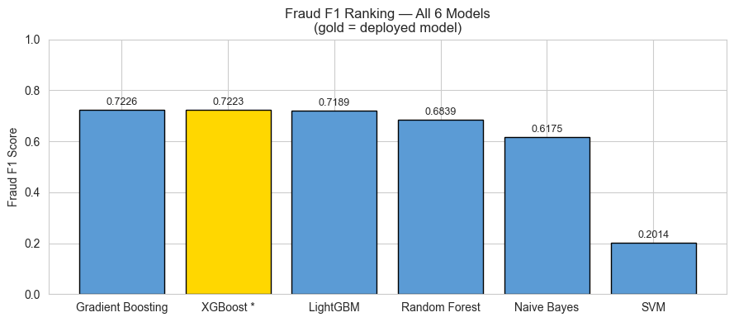
Model
Performance
XGBoost — Best Overall Performance
Comparative results

Slide 8
Supports System Growth
Reduces Long-Term Costs
Modular React + Flask architecture add new fraud rules, ML models, or user roles independently. PostgreSQL scales to millions of transactions with no schema changes.
100% open-source (React, Flask, PostgreSQL, XGBoost, face_recognition) , zero licensing fees. Automated blocking cuts manual fraud review costs significantly for financial institutions.
Scalability &
Sustainability
Social & Economic Impact
Future Work
Protects Rwanda's unbanked population who depend on mobile money. Reduces financial losses due to fraud. Builds public trust in digital financial services, supporting Rwanda's Vision 2050 financial inclusion goals.
Integration with live MTN Rwanda
APIs. Continuous model retraining on real transaction data. Mobile app development. Expansion to other East African MoMo markets.
Economic & social impact

Slide 9
Conclusions
XGBoost hybrid system achieves ROC-AUC 0.9728, outperforming all five baseline models
Biometric face verification successfully gates identity-sensitive high-risk transfers
Conclusion
& Research
Answers
3-tier XAI (rule summary · feature bars · SHAP) delivers role-appropriate transparency
Threshold optimisation (0.38) improved fraud recall without sacrificing overall accuracy
Research Questions — Answered
RQ1 — How accurately?
F1=0.7223, AUC=0.9728, threshold optimised to 0.38
RQ2 — How effective is biometrics?
Key findings
Blocks on mismatch or absent face — 15/15 functional tests passed
RQ3 — How transparent?
Rule summary → customer; feature bar chart → manager; deep SHAP → admin

Slide 10
Live Demo
https://youtu.be/xgC4rUMTiUE

Slide 11
Thank You
Questions & Discussion
RUHAMO Rose · Reg: 25RP21044 · RP Huye College · MoMo Shield

